Slide 1
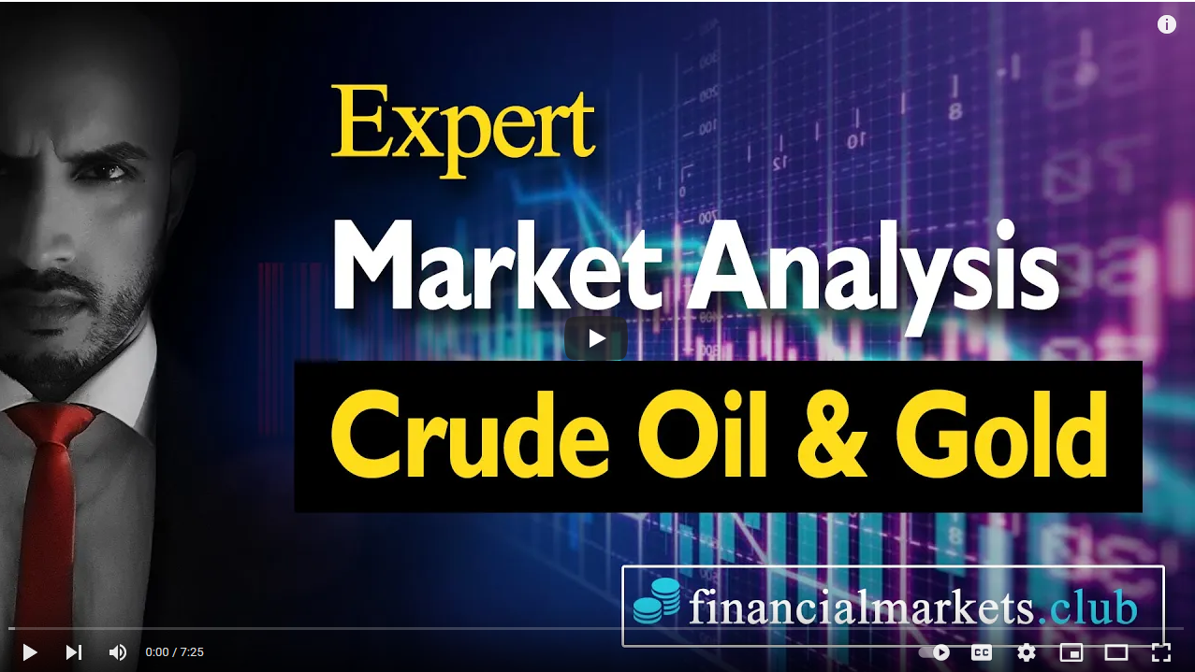
Crude Oil & Gold
Paper Trading Expert
Do you need Help with your Paper Trading?
Hire me as your Freelance
Market Analysis Expert
Link to embed:
https://www.youtube.com/watch?v=6Lr8eOThqYk

Slide 2
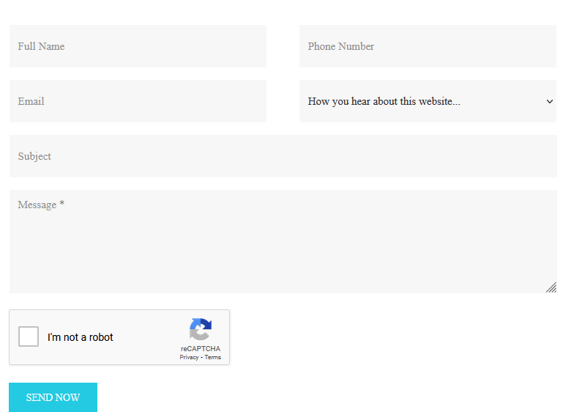
Imagine
5-20% Profit monthly
With my help
My Commodity Trading clients in Dubai average 179% growth per year, doing Paper Trading.
Book a Meeting with me Today to discuss

Slide 3
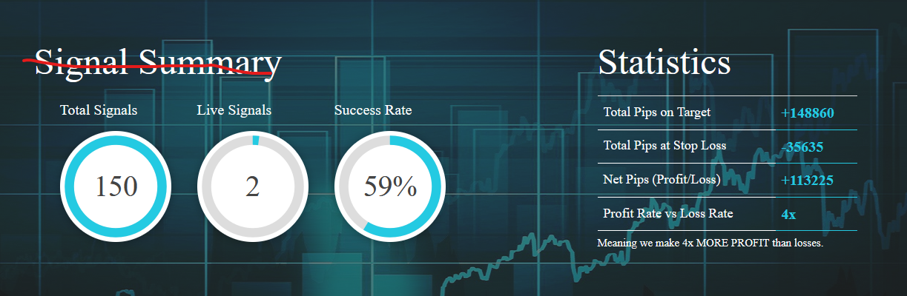
Check my Performance

Slide 4
Success page after submitting form
Thank You
For contacting me <FNAME>
I’ll call you back within 3 hours to discuss how I can help you increase your Paper Trading Profits.

Slide 5
Auto email for submitting the form – use the fm club auto email template that is existing
Subject: Oil, Gold Paper Trading Expert
Body:
Thank You
For contacting me <FNAME>
I’ll call you back within 3 hours to discuss how I can help you increase your Paper Trading Profits.
Incase you need to contact me, my direct number is
UAE: +971 58 540 0412
UK: +44 754 3944 236
Best Regards
Nasir

